Slide 1

Interrupted
Time Series
Experiments
in Python
Drew Fustin
Automaton Data
drewfustin@gmail.com
@drewfustin
@drewfustin | 2017.12.04

Slide 2




Me
Automaton Data [contracting]
drew@automatondata.com
PhD, Physics
Data Scientist
@drewfustin | 2017.12.04

Slide 3

Experiments are Hard
@drewfustin | 2017.12.04

Slide 4

Some are Straightforward
@drewfustin | 2017.12.04

Slide 5
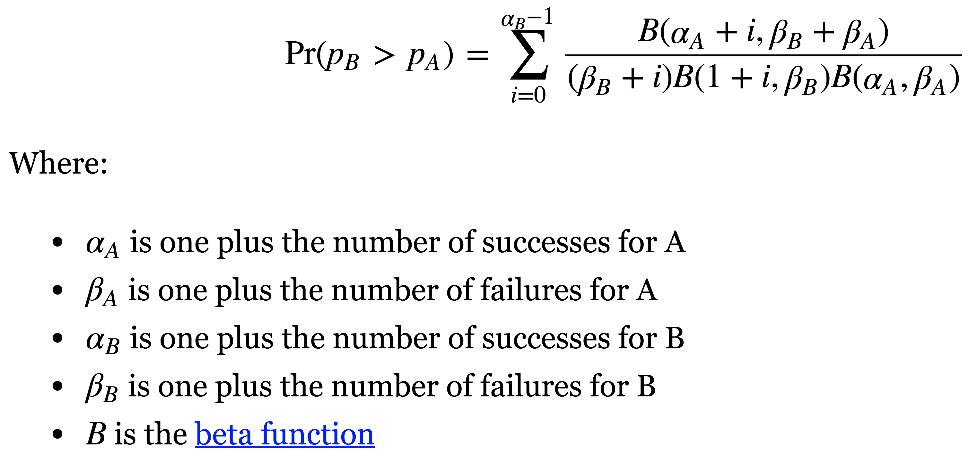
Some are Straightforward
evanmiller.org/bayesian-ab-testing.html
@drewfustin | 2017.12.04

Slide 6
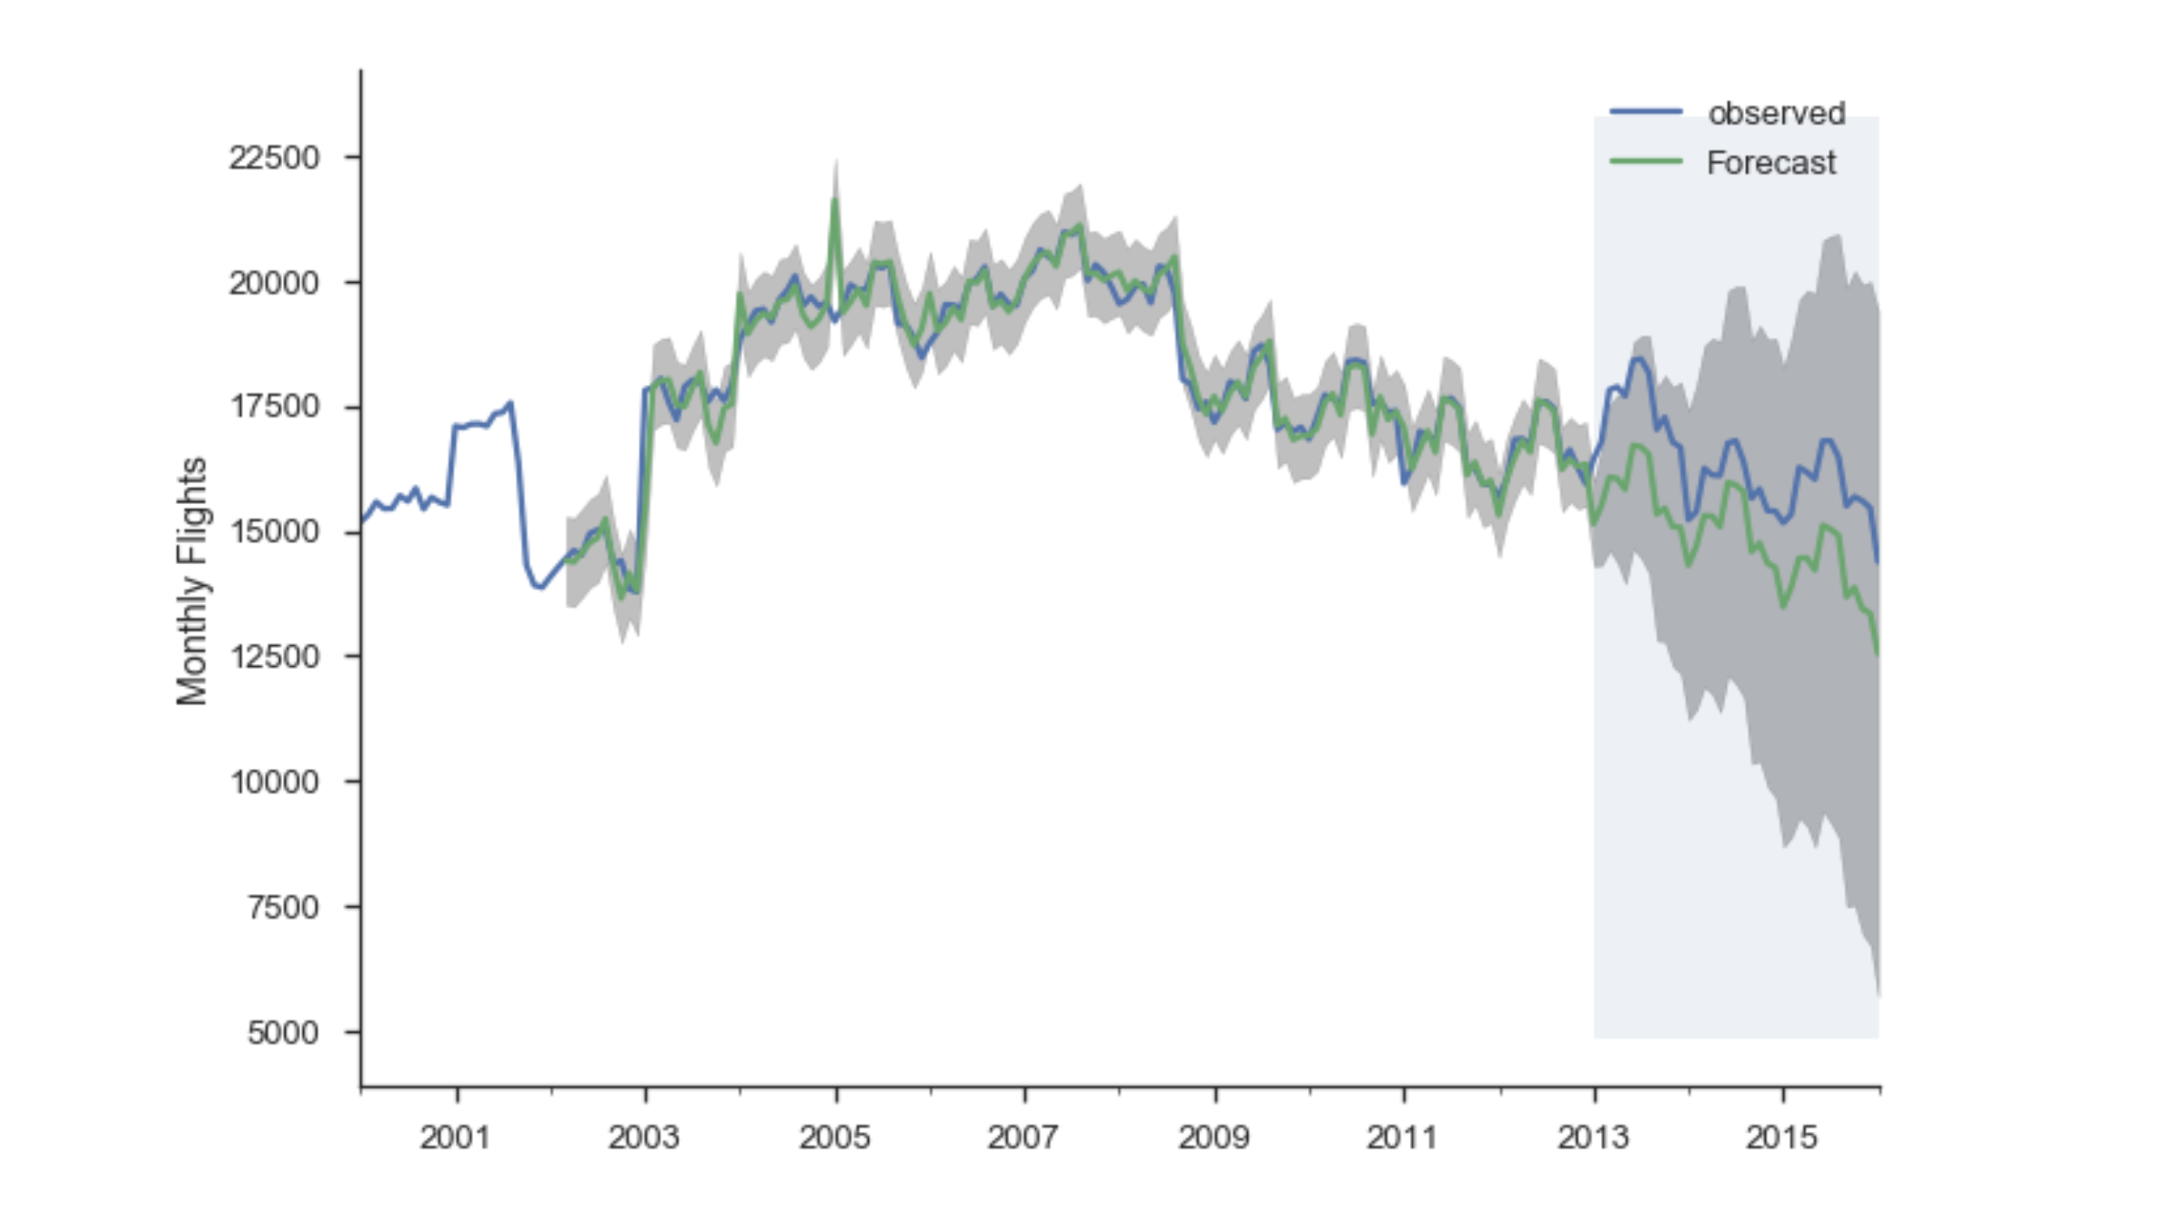
Some are Convoluted
tomaugspurger.github.io/modern-7-timeseries.html
@drewfustin | 2017.12.04

Slide 7
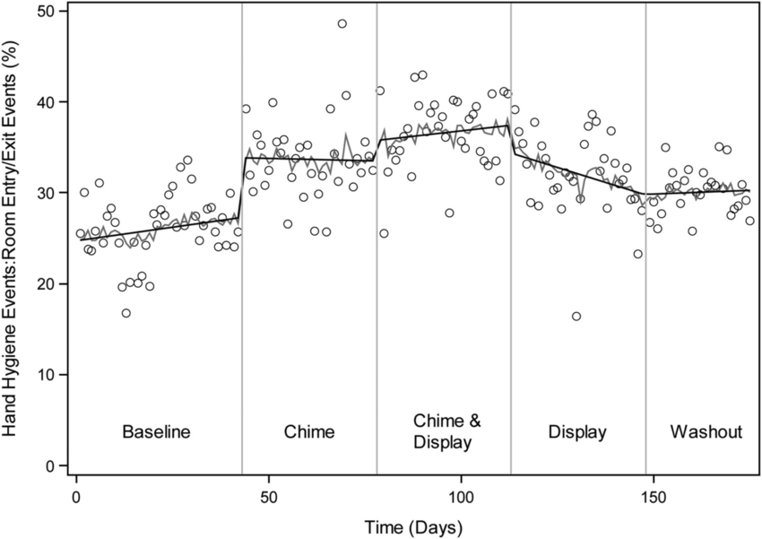
Interrupted Time Series
Ellison, et al
A Prospective Controlled Trial of an Electronic Hand Hygiene Reminder System
@drewfustin | 2017.12.04

Slide 8
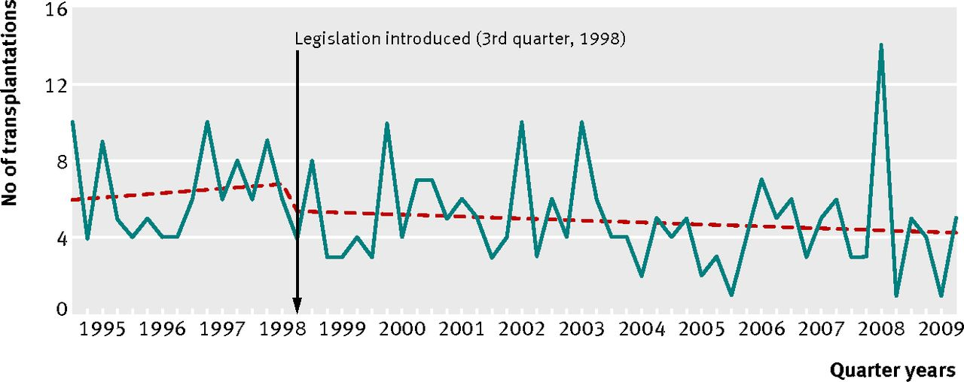
Interrupted Time Series
Hawton, et al
Long term effect of reduced pack sizes of paracetamol on poisoning deaths and liver transplant activity in England and Wales: interrupted time series analyses
@drewfustin | 2017.12.04

Slide 9
Interrupted Time Series
So shaky, they’re called
quasi-experiments
@drewfustin | 2017.12.04

Slide 10
Interrupted Time Series
Related to
regression discontinuity
as time is the running variable,
it is not randomly assigned
(required of RD design)
@drewfustin | 2017.12.04

Slide 11
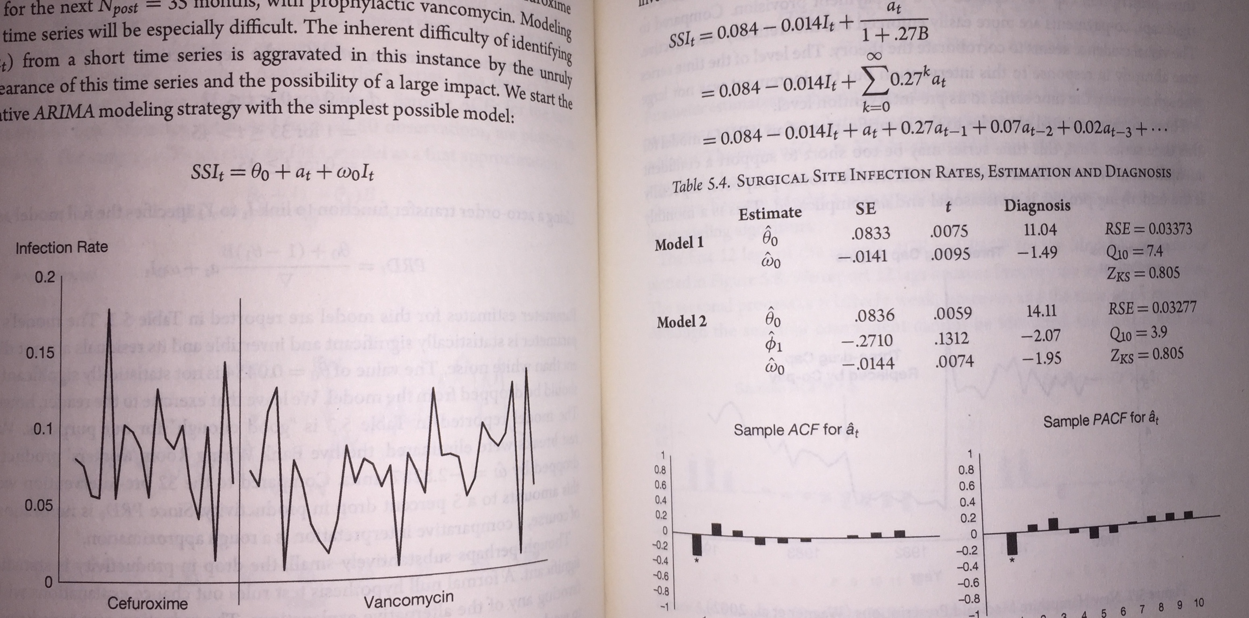
Interrupted Time Series
basic idea #1: fit ARIMA + effect size
McCleary, et al
Design and Analysis of Time Series Experiments
@drewfustin | 2017.12.04

Slide 12
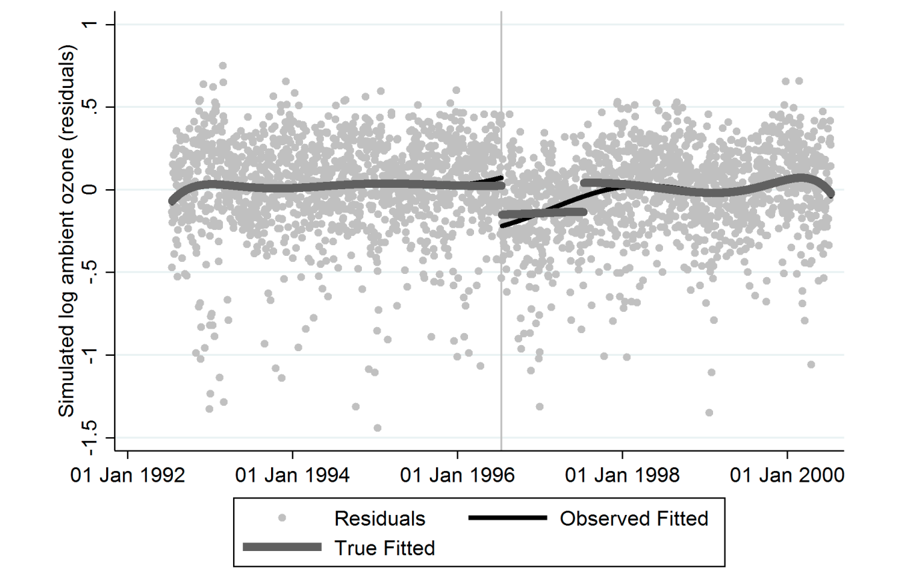
Interrupted Time Series
basic idea #2: fit curves at discontinuity
Hausman and Rapson
Regression Discontinuity in Time: Considerations for Empirical Applications
@drewfustin | 2017.12.04

Slide 13
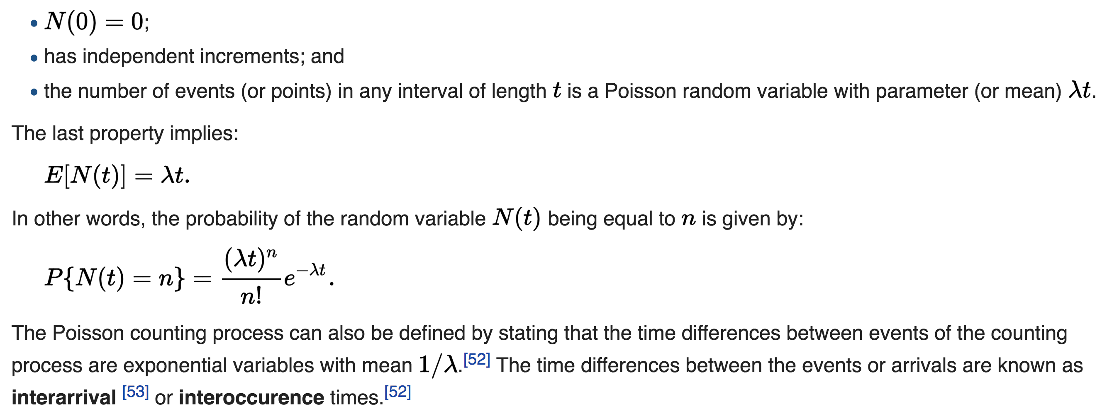
Let’s Simulate Some Data
Homogeneous Poisson
Point Process
λ is fixed in time
@drewfustin | 2017.12.04

Slide 14
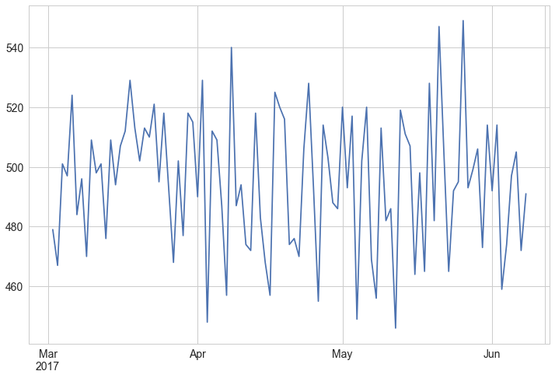
Let’s Simulate Some Data
Homogeneous Poisson
Point Process
λ is fixed in time
cumulatively add events distributed exponentially with rate 1/λ
@drewfustin | 2017.12.04

Slide 15
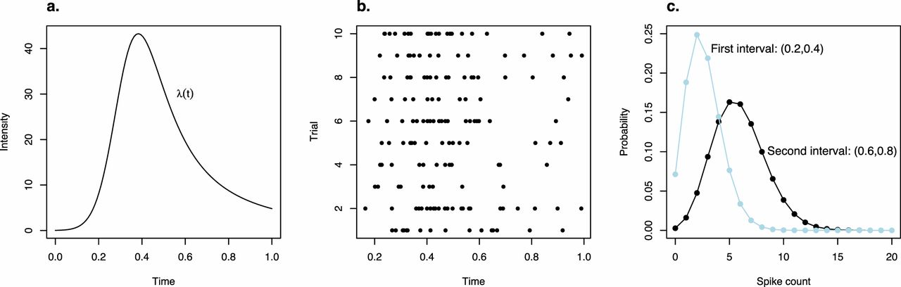
Let’s Simulate Some Data
Nonhomogeneous Poisson
Point Process
λ=λ(t)
Barthelmé, et al
Modeling Fixation locations using spatial point processes
Sim HPP, cut some p=p(t)
@drewfustin | 2017.12.04

Slide 16
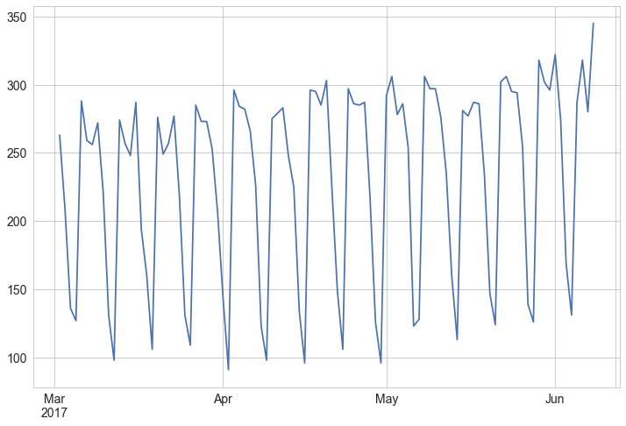
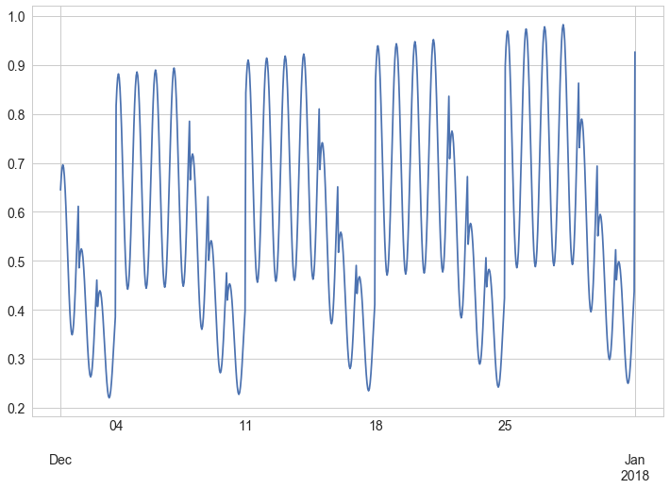
Let’s Simulate Some Data
Nonhomogeneous Poisson
Point Process
λ=λ(t)
@drewfustin | 2017.12.04

Slide 17
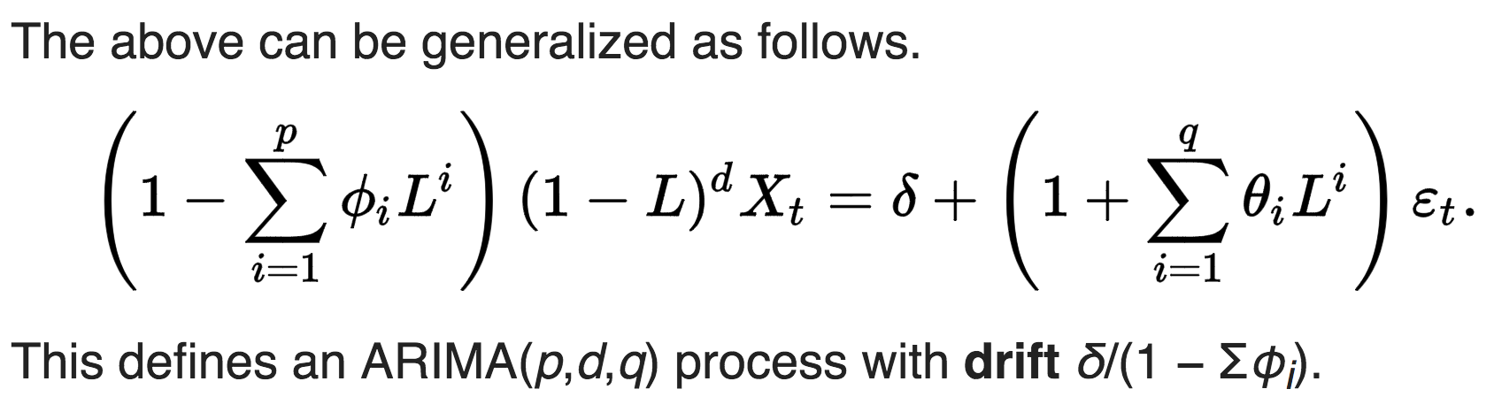
ARIMA Forecasting
Autoregressive (AR)
Integrated (I)
Moving Average (MA)
@drewfustin | 2017.12.04

Slide 18
ARIMA Forecasting
@drewfustin | 2017.12.04

Slide 19
ARIMA Forecasting
Autoregressive (AR)
Integrated (I)
Moving Average (MA)
φ_{p}(B)=(1-φ₁B-φ₂B²-…-φ_{p}B^{p})
θ_{q}(B)=(1-θ₁B-θ₂B²-…-θ_{q}B^{q})
Δ
^{d}(B)=(1-B)^{d}
e.g. ARIMA (1, 1, 0):
(1-φ₁B)(1-B)=1-(1+φ₁)B+φ₁B²
@drewfustin | 2017.12.04

Slide 20
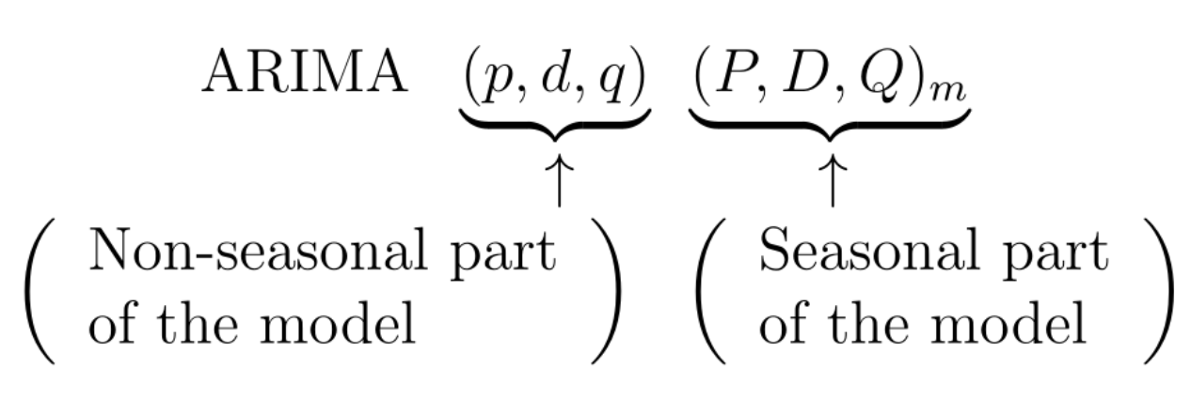
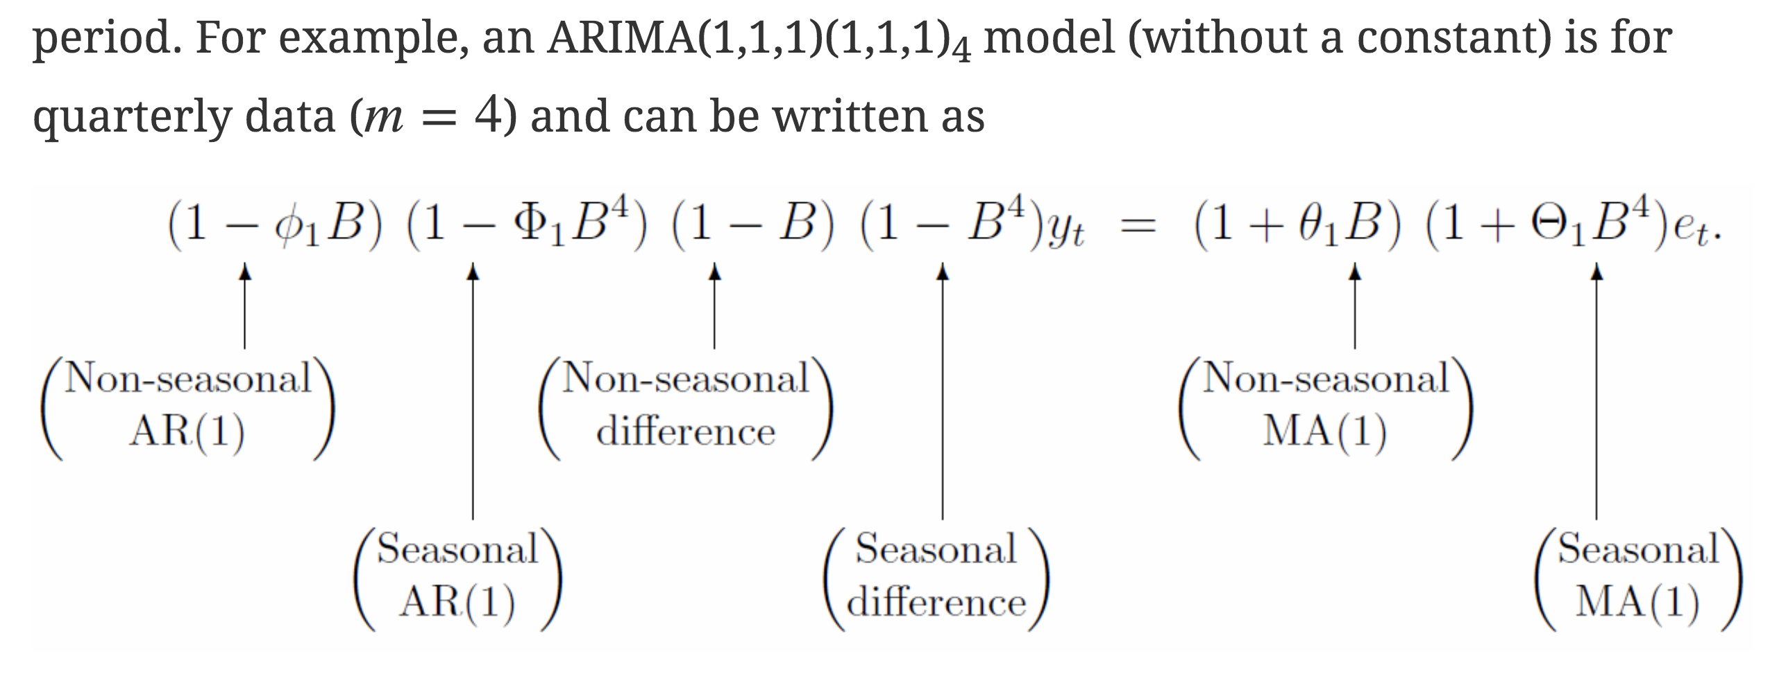
ARIMA Forecasting
Hyndman and Athanasopoulos
Forecasting: principles and practice
@drewfustin | 2017.12.04

Slide 21
ARIMA Forecasting
@drewfustin | 2017.12.04

Slide 22
ARIMA Forecasting
Other Topics
Stationarity: Adjusted Dickey-Fuller Test
Autocorrelation Functions: ACF/PACF
reading those tea leaves
“Memory” differences between AR, I, MA
@drewfustin | 2017.12.04

Slide 23
PyMC3 for ITS Analysis
Generate NHPP
Fit ARIMA to get (p, d, q) order
Add response ~ N (μ_{β},σ_{β}) at t_exp
Use ARIMA ops to iteratively solve y, ε
@drewfustin | 2017.12.04

Slide 24
PyMC3 for ITS Analysis
Generate NHPP
Fit ARIMA to get (p, d, q) order
Add response ~ N (μ_{β},σ_{β}) at t_exp
Use ARIMA ops to iteratively solve y, ε
Potential next step:
Use PyMC3 to check regression discontinuity in across t_exp bound
@drewfustin | 2017.12.04

